Slide 1
TOPIC 4: SELECTION AND PLACEMENT

Slide 2

1. Personnel selection

Slide 3

Personnel selection is the methodical process used to hire (or, less commonly, promote) individuals.

Slide 4
The goal of personnel selection, as all business processes, is to ensure an adequate return on investment.

Slide 5
The procedure of personnel selection includes :
Interviews
Personality Tests
Biographical Data
Cognitive Ability Tests
Physical Ability Tests
Work Samples

Slide 6
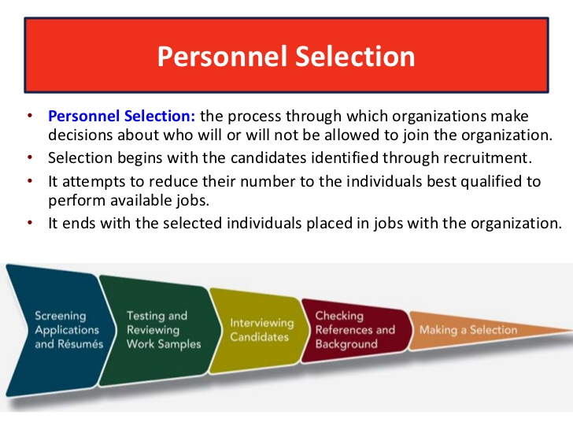

Slide 7
2. Selection methods

Slide 8

INTERVIEWS
Unstructured Interview - involves a procedure where different
questions may be asked of different applicants

Slide 9

Situational Interview- candidates are interviewed about what
actions they would take in various job-related situations.
The job-related situations are usually identified using the critical
incidents job analysis technique.

Slide 10

Behavior Description Interviews- candidates are asked what
actions they have taken in prior job situations that are similar to
situations they may encounter on the job.

Slide 11

Comprehensive Structured Interviews - candidates are asked
questions pertaining to how they would handle job-related situations,
job knowledge, worker requirements, and how the candidate would
perform various job simulations.

Slide 12

Structured Behavioral Interview- This technique involves asking all interviewees standardized questions about how they handled past situations that were similar to situations they may encounter on the job.

Slide 13

Oral Interview Boards - This technique involves asking all interviewees standardized questions about how they handled past situations that were similar to situations they may encounter on the job.

Slide 14
Advantages | Disadvantages
useful for determining if the applicant has requisite communicative or social skills which may be necessary for the job | subjective evaluations are made
interviewer can obtain supplementary information | decisions tend to be made within the first few minutes of the interview with the remainder of the interview used to validate or justify the original decision
used to appraise candidates' verbal fluency | interviewers form stereotypes concerning the characteristics required for success on the job
can assess the applicant's job knowledge | research has shown disproportionate rates of selection between minority and non-minority members using interviews
can be used for selection among equally qualified applicants | negative information seems to be given more weight
enables the supervisor and/or co-workers to determine if there is compatibility between the applicant and the employees | not much evidence of validity of the selection procedure
allows the applicant to ask questions that may reveal additional information useful for making a selection decision | not as reliable as tests
the interview may be modified as needed to gather important information

Slide 15
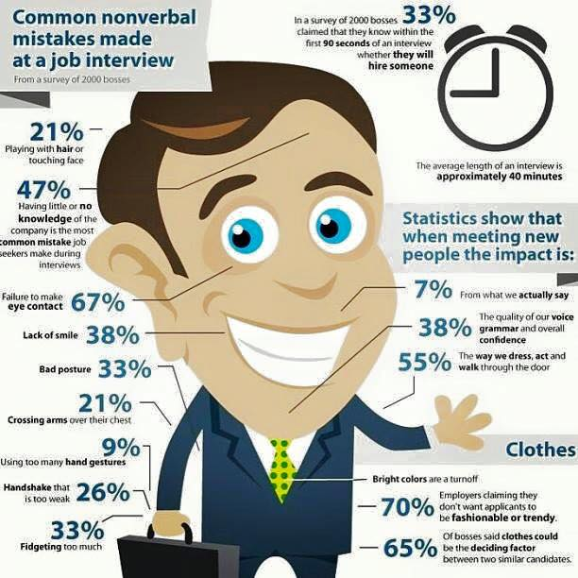

Slide 16
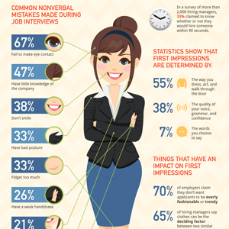

Slide 17

PERSONALITY TESTS
Personal Attribute Inventory - a set of tests and tasks for identifying the type of temperament and key character traits

Slide 18

Personality Adjective Checklist- a comprehensive, objective measure of eight personality styles.

Slide 19

Motives Questionnaires- It is used for the diagnosis of two generalized persistent motives of the personality: the motive of the desire for success and the motive for avoiding failure.

Slide 20

Interests Questionnaires - focused on the definition of educational and professional interests.

Slide 21

The questionnaires of values - values and value orientations are considered as criteria used by people to select and justify their actions, as well as to assess themselves, other people and events.

Slide 22

Questionnaires adjustment - determine the expressed tendency of the individual to positively or negatively react to a certain class of incentives, situations, events.

Slide 23
Advantages | Disadvantages
can result in lower turnover due if applicants are selected for traits that are highly correlated with employees who have high longevity within the organization | difficult to measure personality traits that may not be well defined
can reveal more information about applicant's abilities and interests | applicant's training and experience may have greater impact on job performance than applicant's personality
can identify interpersonal traits that may be needed for certain jobs | responses by applicant may be altered by applicant's desire to respond in a way they feel would result in their selection
 | lack of diversity if all selected applicants have same personality traits
 | cost may be prohibitive for both the test and interpretation of results
 | lack of evidence to support validity of use of personality tests

Slide 24
BIOGRAPHICAL DATA
The content of biographical data instruments varies widely, and may include such areas as leadership, teamwork skills, specific job knowledge and specific skills (e.g., knowledge of certain software, specific mechanical tool use), interpersonal skills, extraversion, creativity, etc.

Slide 25
Advantages | Disadvantages
useful for jobs where a large number of employees are performing the same or similar job | may lead to individuals responding in a way to create a positive decision outcome rather than how they really are (i.e., they may try to positively manage their impression or even fake their response).
useful for jobs where there are a large number of applicants relative to the number of openings
can be administered via paper and pencil or computerized methods easily to large numbers | do not always provide sufficient information for developmental feedback (i.e., individuals cannot change their past).
can be cost effective to administer.
have been demonstrated to produce valid inferences for a number of organizational outcomes (e.g., turnover, performance). | can be time-consuming to develop if not purchased off-the-shelf.
can reduce business costs by identifying individuals for hiring, promotion or training who possess the needed skills and abilities.

Slide 26
COGNITIVE ABILITY TESTS
Advantages | Disadvantages
highly reliable | non-minorities typically score one standard deviation above minorities which may result in adverse impact depending on how the scores are used in the selection process
verbal reasoning and numerical tests have shown high validity for a wide range of jobs
the validity rises with increasing complexity of the job | differences between males and females in abilities (e.g., knowledge of mathematics) may negatively impact the scores of female applicants
combinations of aptitude tests have higher validities than individual tests alone
may be administered in group settings where many applicants can be tested at the same time
scoring of the tests may be completed by computer scanning equipment
lower cost than personality tests

Slide 27
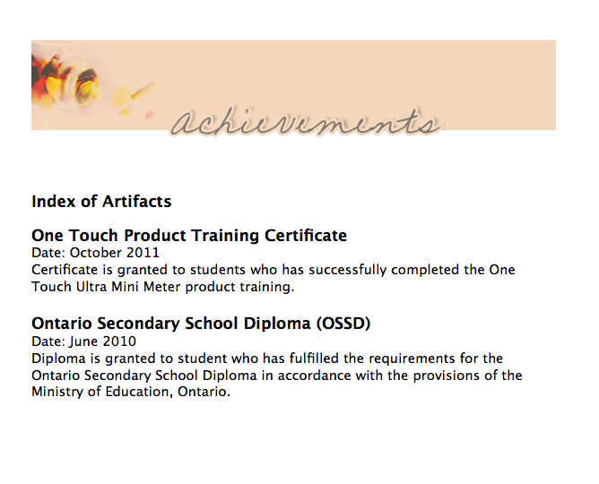
WORK SAMPLE TESTS
Portfolio of achievements - the emphasis is placed on documents confirming success in a certain type of activity

Slide 28

Thematic portfolio - presentation of creative works.

Slide 29

Presentational portfolio - created for presentation at the time of employment, admission to educational institutions

Slide 30

Integrated portfolio - contains all the elements of the above types of portfolios

Slide 31
Advantages | Disadvantages
high reliability | costly to administer; often can only be administered to one applicant at a time
high content validity since work samples are a sample of the actual work performed on the job
low adverse impact | although useful for jobs where tasks and duties can be completed in a short period of time, these tests have less ability to predict performance on jobs where tasks may take days or weeks to complete
because of their relationship to the job, these tests are typically viewed more favorable by examinees than aptitude or personality tests | less able to measure aptitudes of an applicant thus restricting the test to measuring ability to perform the work sample and not more difficult tasks that may be encountered on the job
difficult for applicants to fake job proficiency which helps to increase the relationship between
score on the test and performance on the job
Work Sample tests use equipment that is the same or substantially similar to the actual equipment used on the job

Slide 32
PHYSICAL ABILITIES TESTS
Advantages | Disadvantages
can idendentify individuals who are physically unable to perform the essential functions of a job without risking injury to themselves or others | costly to administer
can result in decreased costs related to disability/medical claims, insurance, and workers compensation
decreased absenteeism | requirements must be shown to be job related through a thorough job analysis
 | may have age based disparate impact against older applicants

Slide 33

SELF-ASSESSMENTS
This technique involves applicants generating self-ratings on relevant performance

Slide 34

ASSESSMENT CENTERS
An Assessment Center consists of a standardized evaluation of behavior based on multiple evaluations including: job-related simulations, interviews, and/or psychological tests.

Slide 35
3. Employee placement

Slide 36

PLACEMENT it’s the distribution of available staff and units of management and other units, taking into account the requirements where they could most effectively work.

Slide 37
The information given during the orientation programme includes:
Employee’s layout
Type of organizational structure
Departmental goals
General rules and regulations
Standing Orders
Grievance system or procedure

Slide 38

PRINCIPLES OF PLACEMENT
1. Man should be placed on the job according to the requirements of the job.

Slide 39

2. The job should be offered to the person according to his qualification.

Slide 40

3. The employee should be made conversant with the working conditions prevailing in the organization and all things relating to the job.

Slide 41

4. While introducing the job to the new employees, an effort should be made to develop a sense of loyalty and cooperation in him so that he may realize his responsibility better towards the job and the organization.

Slide 42

5. The placement should be ready before the joining date of the newly selected person.

Slide 43

6. The placement in the initial period may be temporary as changes are likely after the completion of training.

Slide 44

PROBLEMS OF THE PLACEMENT
1. Independent Jobs: In the independent jobs the non-overlapping territories are allocated to each employee e.g., in the sales.

Slide 45

2. The dependent jobs may be sequential or pooled.

Slide 46

3. In the pooled jobs, there is a high interdependence among the jobs. The final output is the result of the contribution of all the workers.

Slide 47
Lection is over! Thank you for your attention!

